Slide 1
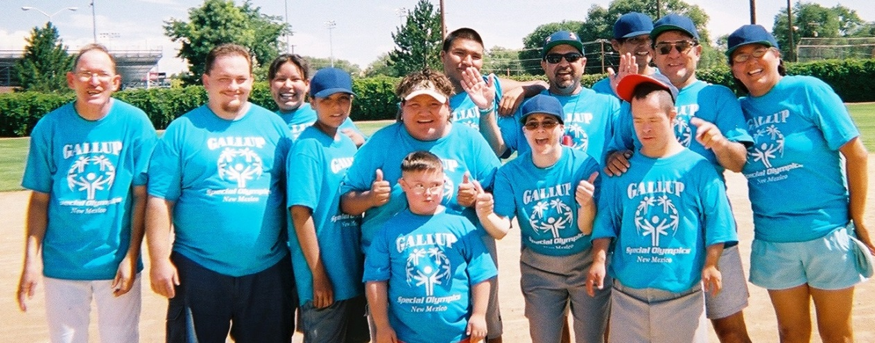
Special Olympics New Mexico General Orientation
The First Step to
Becoming an SONM
Coach, Unified Partner and Volunteer
Updated 1/6/2014

Slide 2
Special Olympics Mission
The mission of Special Olympics is to provide year-round sports training and athletic competition in a variety of Olympic-type sports for people 8 years of age and older with intellectual disabilities, giving them continuing opportunities to develop physical fitness, demonstrate courage, experience joy and participate in a sharing of gifts, skills and friendship with their families, other Special Olympics athletes and the community.

Slide 3
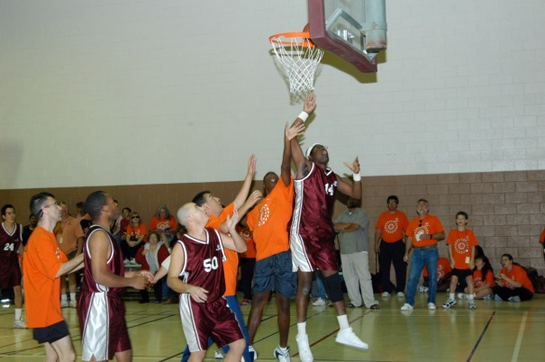
Special Olympics Mission
Components
Year-round
Sports training and competition
Olympic-type sports
Individual with intellectual disability
Outcomes
Physical fitness
Courage and joy
Sharing of gifts and skills
Friendship
Families
Athletes
Community

Slide 4
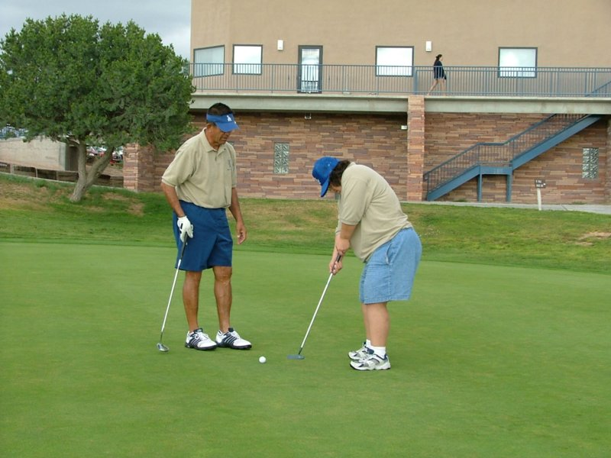
Special Olympics Philosophy
Individuals with intellectual
disabilities:
Receive appropriate instruction
and encouragement
Receive consistent training
Compete among those of equal abilities
Result = Personal Growth

Slide 5
Organizational Structure
Local
Local Athletes & Coaches
Area/County Sub-Programs
National
51 United States
Programs
Mexico
Canada
Caribbean
Regional
Africa
Asia-
Pacific
Europe-
Eurasia
North
America
Latin
America
Middle East-
North Africa
Global
Special Olympics, Inc.
Headquarters, Washington, DC
Special Olympics, Inc.
Board of Directors

Slide 6
SONM Structure
Special Olympics New Mexico is the accredited Special Olympics program for the state of New Mexico. SONM is based in Albuquerque and is currently directed by a staff of 11 with the assistance of 5 area directors.
SONM oversees the facilitation of six state-level and over 45 area-level competitions yearly and provides oversight for the 72 local teams competing in 13 different Olympic type sports offered at the state-level in New Mexico. In addition, SONM staff are responsible for the implementation of volunteer training through our approved Coaches Education Program providing sports specific training to over 1000 coaches each year.

Slide 7
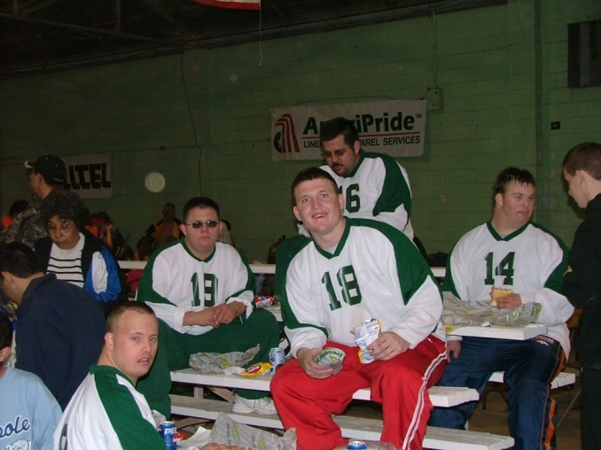
Statement of Eligibility
Special Olympics training and competition is provided for:
Persons with intellectual disabilities as identified by an agency or professional
Aged 8 years or older
Persons registered with Special Olympics New Mexico

Slide 8
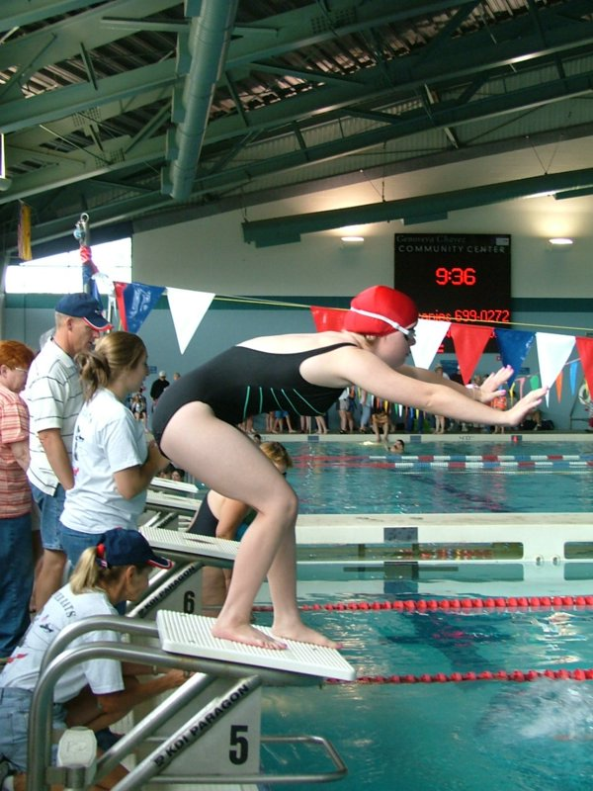
Unique From Other Sports Organizations
Sports opportunities for all ability levels
Divisioning for equitable competition
Awards for all participants
Random draw for advancement to higher
levels of competition for athletes who have
completed the minimum training and competition
requirements.

Slide 9
Sports Rules
Based on International and National Governing Body Rules
Contain few modifications
Provide sports & events for all ability levels
Govern all Special Olympics competitions

Slide 10
Divisioning
Provide all competitors a chance to excel
No more than 3-8 athletes or teams per division
Grouped by age & gender (gender when appropriate)
Further separated by ABILITY:
For individual competition -
10-15% guideline and preliminaries
For team competition –
Skills Assessment Tests and
Classification rounds of competition

Slide 11
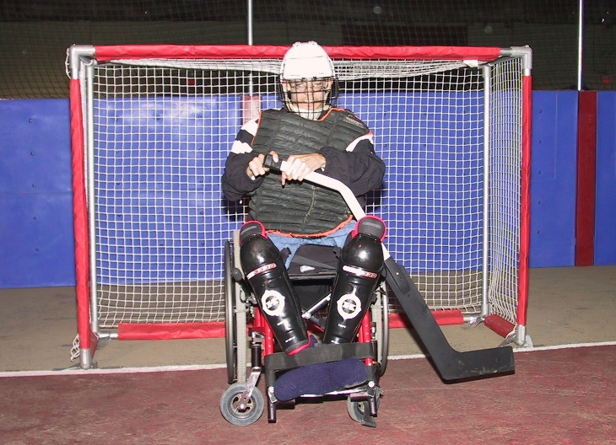
Competition Opportunities
Scrimmages
Area Competitions
State Competitions
National Games
On a four year rotation
World Games
On a four year rotation

Slide 12
Proven Benefits of Special Olympics Participation
Improved strength, stamina & motor skills
Improved self-esteem & self-confidence
Healthy, skill-dependable employees
Greater independent participation in the community
Increased social skills through teamwork, interaction with peers and people without intellectual disabilities

Slide 13
Healthy Athletes
The mission of Special Olympics Healthy Athletes®, developed in 1996, is to improve athletes' ability to train and compete in Special Olympics. Healthy Athletes is designed to help Special Olympics athletes improve their health and fitness, leading to enhanced sports experience and improved well-being.
The key objectives of Special Olympics Healthy Athletes® are:
Improve access and health care for Special Olympics athletes at event-based health screenings
Make referrals to local health practitioners when appropriate
Train health care professionals and students in the health professions about the needs and care of people with intellectual disabilities
Collect, analyze and disseminate data on the health status and needs of people with intellectual disabilities
Advocate for improved health policies and programs for person with intellectual disabilities.

Slide 14
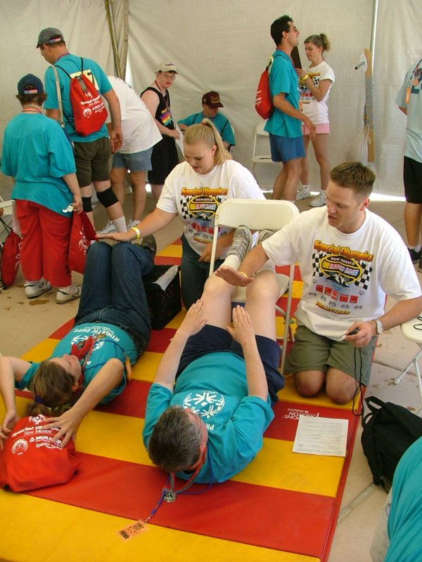
Healthy Athletes
The Healthy Athletes® initiatives are:
Fit Feet
FunFitness
Special Smiles
Healthy Hearing
Opening Eyes

Slide 15
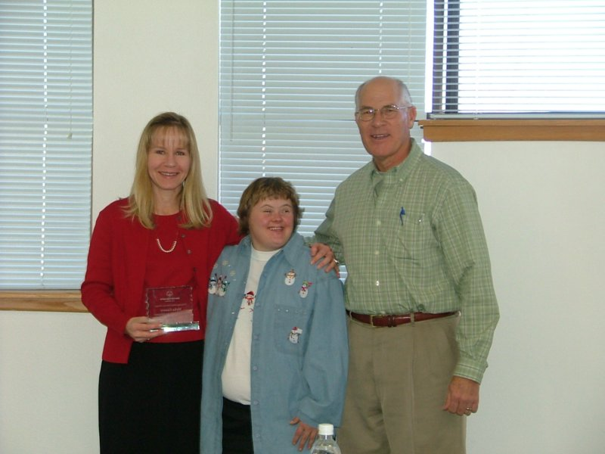
Other Opportunities available for Special Olympics Athletes
Athlete Leadership Programs
Involves athletes in decisions affecting Special Olympics
Global Messenger Program
Teaches athletes public speaking skills
Athletes as Coaches
Athletes as Officials
Athletes as Board Members

Slide 16
Unified Sports
Special Olympics Unified Sports® is an initiative that combines approximately equal numbers of Special Olympics athletes and athletes without intellectual disabilities (called Partners) on sports teams for training and competition. The focus is then on the abilities of the teammates, not the disabilities.
Special Olympics New Mexico offers Unified Sports® competition in Volleyball, Bocce, Golf, Softball, Aquatics and Athletics.

Slide 17
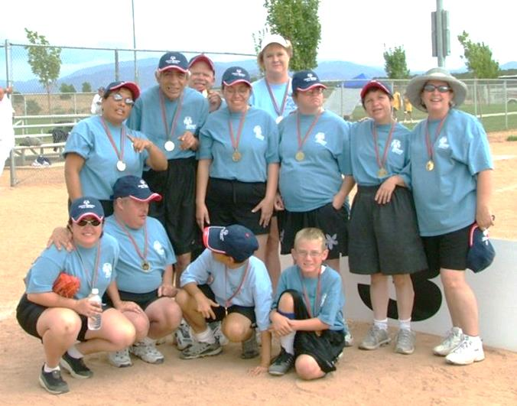
Unified Sports Enables Athletes To:
Learn new sports; develop higher-level sports skills;
Have new competition experiences
Experience meaningful inclusion as each athlete is ensured of playing a valued role on the team;
Socialize with peers and form friendships; and
Participate in their communities and
have choices outside of Special Olympics

Slide 18
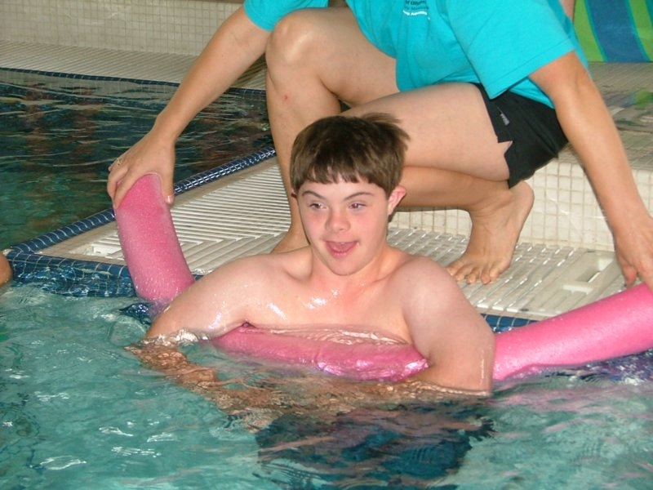
SONM Sports
Winter Sports
Poly Hockey
Summer Games
Athletics
Bocce
Unified Volleyball
Soccer
Four Corners
Aquatics
Unified Flag Football
Unified Softball
Golf
Holiday Classic
Bowling
Basketball
Separate Seasons
Unified Team Bowling
Equestrian

Slide 19
How to Become a Certified SONM Coach
Complete an SONM “A” Volunteer Application through the online volunteer portal found at www.sonm.org
Review the General Orientation and Protective Behaviors PowerPoint presentations (or attend an approved training)
Complete and submit the General Orientation and Protective Behaviors quizzes found at www.sonm.org
If you are new to SONM please notify your Head Coach you need Sport Specific Training. Your Head Coach will contact the SONM Office to set up a training/mentoring schedule.
Once your training/mentoring has been completed, you must complete an Application for Sports Certification and pass the Sport Specific Quiz which will be given to you by the SONM office.
Recertification in your sport must be completed every three years

Slide 20
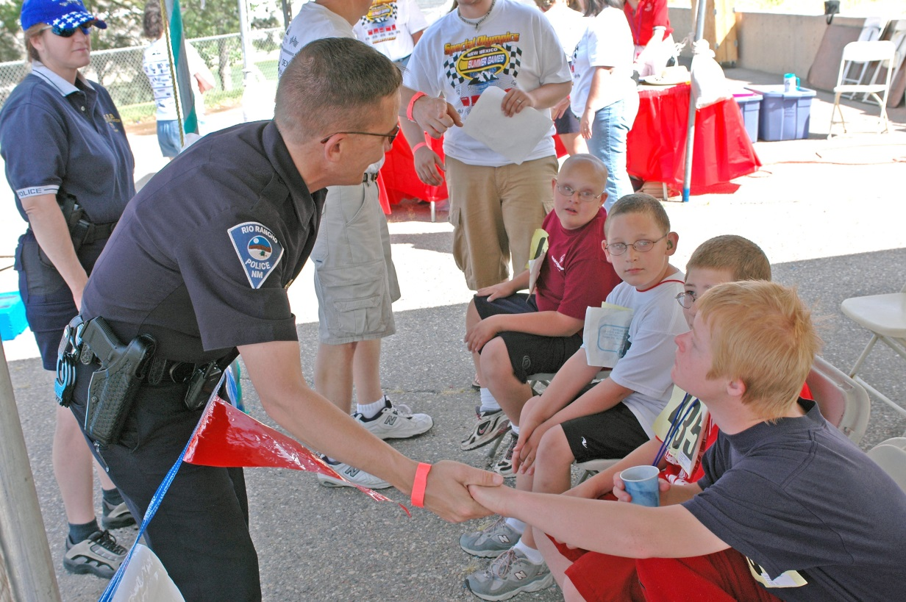
Special Olympics New Mexico Protective Behaviors

Slide 21
Protecting Special Olympics Athletes
Preventing physical abuse
No corporal punishment
Prevent burns by checking the temperature of water (showers/bath)
Do not withhold water or food
Dispense only prescribed medications as prescribed by a physician and as indicated on an athletes consent form signed by his or her parent or legal guardian

Slide 22
Protecting Special Olympics Athletes
Preventing emotional abuse
Profanity, cursing or threatening athletes to improve performance or control behavior is not permitted
Provide constructive and positive discipline
Use of demeaning nicknames is not permitted

Slide 23
Protecting Special Olympics Athletes
Preventing sexual abuse
Provide at least two adults to supervise athletes changing, showering or toileting
Hugs should be open and respect limits set by athletes and volunteers
Private conferences should be held within sight of others
Provide appropriate sleeping arrangements
Educate athletes, partners, volunteers and family members about appropriate contact

Slide 24
Tips for Trips
Separate accommodations should be arranged for male and female athletes
Hall monitors should be assigned to provide security
Roommates should be matched based on intellectual functioning and size of the athletes
Explain the rules of behavior for trips

Slide 25
Responding to Signs/Allegations of Abuse
Legal
Reporting to appropriate authority (SO Executive Director)
State immunity provision for reporting
SO Program Policies
Complete a Special Olympics Incident Report
SONM will suspend the alleged abuser throughout investigation
SONM will contact appropriate protective services agency
SONM representative to be only media spokesperson

Slide 26
Volunteer Code of Conduct
As a Special Olympics volunteer, I agree that while serving as a volunteer, I will:
Provide for the general welfare, health and safety of all Special Olympics athletes and volunteers.
Dress and act in an appropriate manner at all times.
Follow the established rules and guidelines of Special Olympics Program, Special Olympics Inc. and/or agency involved with Special Olympics Program.
Report any emergencies to the appropriate authorities after first taking immediate action to ensure the health and safety of the participants.
Abstain from the consumption or use of all alcohol, tobacco products and illegal substances while involved with ANY Special Olympics Program event, competition or training school.
Not engage in any inappropriate contact or relationship with athletes, volunteers or other participants of Special Olympics Program.

Slide 27
Special Olympics Volunteer Oath
I promise to give of the time in my life so that Special Olympics athletes can have the time of their lives. I promise to support Special Olympics, not just as an expression of charity, but as a form of respect for my fellow human beings. I promise to spread the word of volunteerism because, in giving, I receive so much more in return.

Slide 28
Putting It All Together
TRAINING is the key
COMPETITION is the means
Skill, confidence, courage & joy are the OUTCOMES
Better preparation for life is the GOAL
Lifelong skills & increased independence are the RESULTS

Slide 29
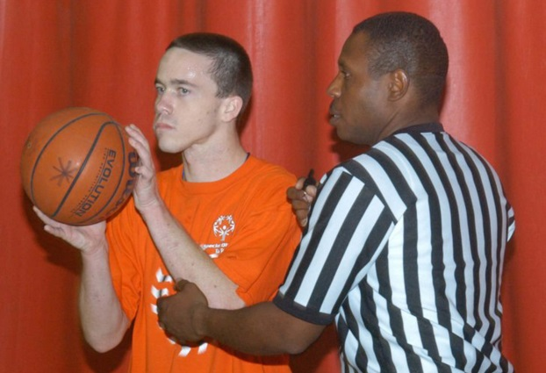
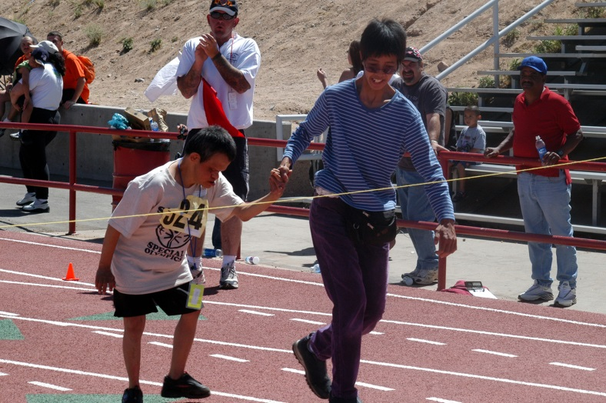
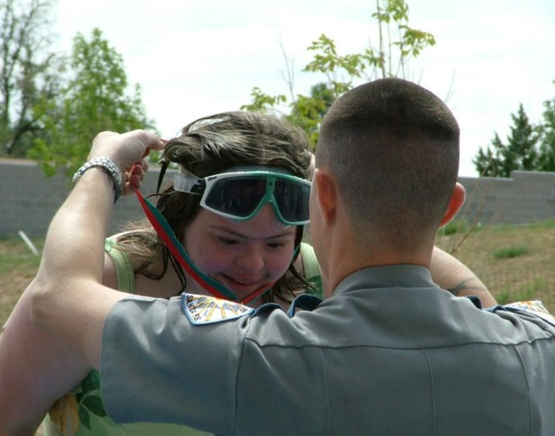
Thank You For Volunteering With Special Olympics New Mexico

